Slide 1
Lecture 7
Objects and Classes
An Introduction to Data Abstraction
MIT AITI
June 13th, 2005

Slide 2
What do we know so far?
Primitives: int, double, boolean, String*
Variables: Stores values of one type.
Arrays: Store many of the same type.
Control Structures: If-then, For Loops.
Methods: Block of code that we can pass arguments to and run anytime.
Is this all we need?

Slide 3
So what’s the problem?
Some data “sticks” together.
  String[] names
  int[] grades
Methods start to get complicated.
Methods can only return one type.
Programmers don’t want to think about all the underlying types.

Slide 4
Abstraction
Objects are tools for abstraction.
We abstract away details to deal with complex problems.
Abstraction is a fundamental concept in computer science.
There can be too much abstraction.
The art is knowing which details to hide away and which to preserve.

Slide 5
What is an object?
Objects have two parts:
  State: Properties of an object.
  Behavior: Things the object can do.
Car Example:
  State: Color, engine size, automatic
  Behavior: Brake, accelerate, shift gear
Person Example:
  State: Height, weight, gender, age
  Behavior: Eat, sleep, exercise, study

Slide 6
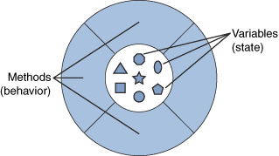
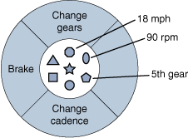
What is an Object?
A Generic Object
An Bicycle Object

Slide 7
Why use objects?
Modularity: Once we define an object, we can reuse it for other applications.
Information Hiding: Programmers don’t need to know exactly how the object works. Just the interface.
Example:
  Different cars can use the same parts.
  You don’t need to know how an engine works in order to drive a car.

Slide 8
Our first Class: LightSwitch
class LightSwitch {
boolean on = true;
}
The keyword class tells java that we’re defining a new type of Object.
Classes are a blueprint.
Objects are instances of classes.
Everything in Java (except primitives) are Objects and have a Class.

Slide 9
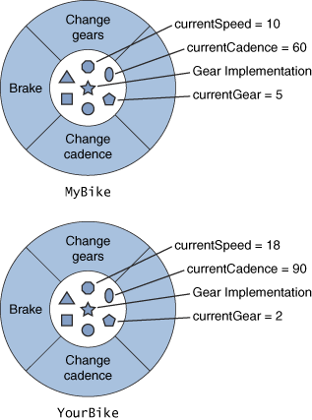
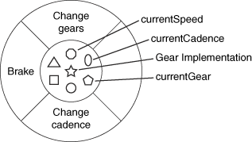
Classes
A Bicycle Class
Two instances of the Bicycle Class

Slide 10
Our first Class: LightSwitch
class LightSwitch {
boolean isOn = true;
}
What state do LightSwitches have?
State stored in fields; here it’s “isOn”.
Fields are accessed using:
  variableName.fieldName
  (We’ll discuss other types of fields later.)
What behavior do LightSwitches have?

Slide 11
Adding Behavior
class LightSwitch {
boolean isOn = true;
void flip() {
this.isOn = !this.isOn;
}
}
The this keyword means this particular object. Objects know themselves.
this.isOn accesses the isOn field.
What behavior does LightSwitch have now?

Slide 12
Using Objects
public static void main(String[] args) {
    LightSwitch s = new LightSwitch();
    System.out.println(s.isOn);
    s.flip();
    System.out.println(s.isOn);
}
The new keyword creates a new object.
new must be followed by a constructor.
We call methods like:
  variableName.methodName(arguments)
What does this code output?

Slide 13
Constructors
Constructors provide objects with the data they need to initialize themselves, like “How to Assemble” instructions.
Objects have a default constructor that takes no arguments, like LightSwitch().
We can define our own constructors that take any number of arguments.
Constructors have NO return type and must be named the same as the class:
  ClassName(argument signature) { body }

Slide 14
Constructors
class LightSwitch {
boolean isOn;
  void flip() {
  this.isOn = !this.isOn;
  }
  LightSwitch(boolean startState) {
  this.isOn = startState;
  }
}
The LightSwitch() constructor no longer works. How do we instantiate an object?

Slide 15
Multiple Constructors
We can have multiple constructors.
Constructors can call each other.
  LightSwitch() {
  LightSwitch(true);
  }
  LightSwitch(boolean startState){
  this.isOn = isOn;
  }

Slide 16
Pop Quiz
What two properties do objects have?
What is the difference between a class and an object?
What is a field?
What does the this keyword mean?
What does the new keyword do?
What is a constructor?

Slide 17
BankAccount Example
class BankAccount {
  double balance;
  String name;
  BankAccount(String name,
  double openBalance){
  this.name = name;
  this.balance = openBalance;
  } // Continued next slide
  …

Slide 18
BankAccount Example
  …
  double deposit(double amount) {
  balance += amount;
  return balance;
  }
  boolean withdraw(double amount) {
  if (amount < balance) {
  balance -= amount;
  return true;
  } else return false;
  }
  }// End BankAccount Class

